Slide 1


Slide 2
PROBABILITY-1

Slide 3
PROBABILITY:
Probability is a measure of the likelihood that a specific event will occur. It is expressed as a number between 0 and 1, where 0 indicates that the event will not occur, and 1 indicates that the event will certainly occur. The probability of an event A is denoted as P(A).
SAMPLE SPACE:
The sample space is the set of all possible outcomes of a random experiment. For example, if you roll a six-sided die, the sample space is {1, 2, 3, 4, 5, 6}.

Slide 4
RANDOM EXPERIMENT :
An experiment in which all possible outcomes are known and the exact output cannot
be be predicted in advance- tossing coins, rolling dice.
EXAMPLE OF SAMPLE SPACE:
1 coin {H, T} = 2
2 coin {HH, TT, HT, TH} = 4
1 dice {1, 2, 3, 4, 5, 6} = 6

Slide 5

SOME IMPORTANT POINTS OF PROBABILITY:
Probability of sure event is 1.
Probability of impossible event is 0.
Any event 𝟎 ≤ 𝑷 ≤ 𝟏.
The probability of any event varies from 0 to 1
P(no event occur) = 1- P( at least one event occur)

Slide 6
cards
Paying cards (52)
Red (26) Black (26)
Heart (13) Diamond (13) Spade (13) Club (13)
Total cards : (Acc), (2,3,4,5,6,7,8,9,10),(Jack, Queen, king)
face card _ (J / Q / K) ➔ 3 (in 1 particular house)
Honour card _ (ACC / J / Q / K) ➔ 4
ordinarey (no. cards) - 2 to 10 ➔ 9
Total face card =) 12 (3x4 house) - red (6) ; black (6)
Total honour card =) 16(4x4 house) - red (8) ; black (8)
Total ordinary card ⇒ 36 (9x4 house) - red (18) ; black (18)

Slide 7
Cards:
A card is drawn from a pack of cards.What is the probability that it is:
a) A red card
b) A club card
c) An ordinary black card
d) A face card but not of red colour
e) A card having the number less than 8
f) An ordinary card of heart
g) An ace of red colour
h) A black card having the number a multiple of 4
Notes:
Ans: a) -, 26/52 = ½
b) 13/52 = 1/4
c) 18/52 =9/26
d) 6/52 =3/26
e) 2 to 8 => 6*4(house)/total =>24/52 =6/13
f) 9/52
g) 2/52 =>1/26
h) (2,4) => only black =4/52 =1/13

Slide 8
From a deck of 52 playing cards, 2 cards are drawn. What is the probability that it has
Two Jacks
No Face Card
No Ordinary card
Exactly One King
One Ace & One King card
Notes:
Ans:
4C2 / 52C2 ➔ 4*3 / 52*51 ➔ 1 / 221
40C2 / 52C2 ➔ 40*39 / 52*51 ➔ 10 / 17
16C2 / 52C2 ➔ 16*15 / 52*51 ➔ 20/221
4C1 * 48C1 / 52C2
4C1 * 4C1 / 52C2

Slide 9
PRACTICE QUESTIONS:
1. In a lottery, there are 10 prizes and 25 blanks. A lottery is drawn at random. What is
the probability of getting a prize?
a) 1/10
b) 2/5
c) 2/7
d) 5/2
2. . A letter of the English alphabet is chosen at random. Probability of getting a vowel is?
5/26
6/25
¼
5/21
Notes:
Ans: 1. c) 2/7
2. a) 5/26
Total no. of lottery tickets is 35 (10 prize and 25 blank)No. of prizes is 10
Therefore, 10 times out 35 a prize is won.
Let E be the event of drawing a lottery ticket
We know that, Probability P(E) =(No.of favorable outcomes)/(Total no.of possible outcomes)=10/35=2/7

Slide 10
PRACTICE QUESTIONS:
3. A single letter is selected at random from the word ‘PROBABILITY’. The probability
that the selected letter is vowel is?
2/11
3/11
4/11
5/11
4. The probability that an ordinary or a non-leap year has 53 Sunday, is?
a) 2/7
b) 1/7
c) 3/7
d) None
Notes:
Ans: 3. c) 4/11
4. b) 1/7
A non-leap year has 365 days
A year has 52 weeks. Hence there will be 52 Sundays for sure.
52 weeks = 52 x 7 = 364 days .
365– 364 = 1 day extra.
In a non-leap year there will be 52 Sundays and 1day will be left.
This 1 day can be Sunday, Monday, Tuesday, Wednesday, Thursday, friday, Saturday, Sunday.
Of these total 7 outcomes, the favourable outcomes are 1.
Hence the probability of getting 53 sundays = 1 / 7.

Slide 11
PRACTICE QUESTIONS:
5. A bag contains balls numbered 1, 2, 3……. 30. One ball is drawn from the bag at random. What is the probability that the number on the ball drawn is divisible by 4 or 6?
a) 1/5
b) 1/3
c) 3/10
d) 2/5
6. Two integers are selected at random from the first 11 natural numbers. If the sum of the integers is even, then the probability that both the numbers are odd is?
13/121
3/11
4/9
5/11
Notes:
Ans : 5. b) 1/3
6. b) 3/11
5) Number of divisible by 4 = 7 Number of divisible by 6 = 5 Number of divisible by (4 & 6) = 2 Total number = 7 + 5 - 2 = 10 Probability = 10/30 ➔ 1/3
6) The odd numbers=1,3,5,7,9,11
Probability of selecting two odd numbers =6C2 / 11C2 = 6×5 / 11×10 = 3 / 11

Slide 12
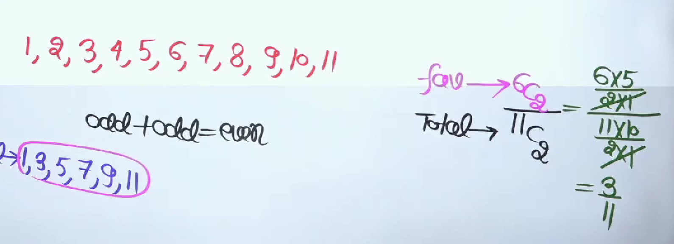
ANSWER:

Slide 13
PRACTICE QUESTIONS:
7. A bag contains cards numbered between 33 and 92. If one card is drawn from the bag, the probability that the number on the drawn card is a perfect square is?
a) 5/59
b) 4/59
c) 2/29
d) 1/12
8. 10 persons are seated at a round table. The probability that two particular persons sit
together is?
a) 1/5
b) 2/9
c) 3/7
d) 4/9
Notes:
Ans: 7. c) 2/29
8. b) 2/9
Total 10 people in circular ➔ n-1! ➔ 10-1 ! ➔ 9!
2 People Sits Together Means Take 2 People As Single Entity
Total 9 Peoples ➔ circular = (9-1)! = 8!
2 people can arrange 2 ways ➔ 2!
➔ 8! * 2! / 9! => 2/9

Slide 14
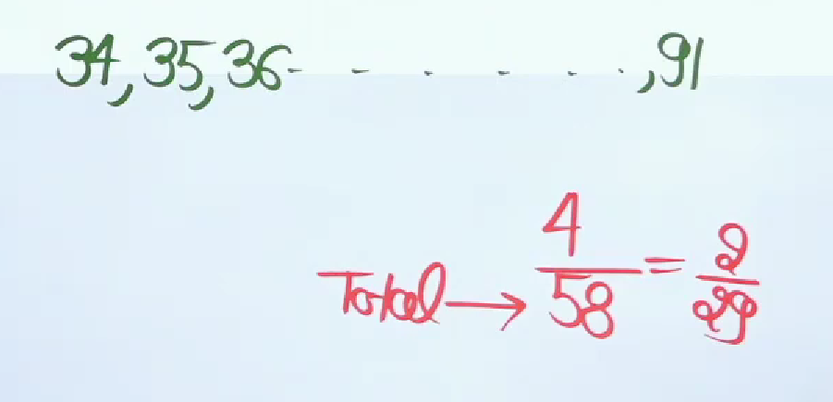
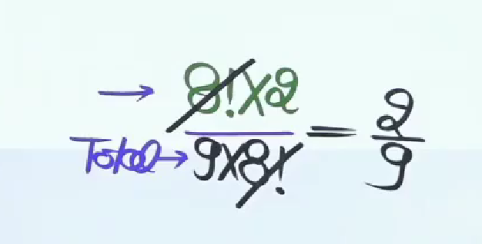
ANSWER:

Slide 15
Mutually Exclusive Events:
If two or more events have no point in common i.e. if they cannot occur
simultaneously the events are said to be mutually exclusive.
Then probability of two events A & B is P(A) + P(B).
Independent Events:
Two events are said to be independent if the occurrence or non- occurrence of one
event does not influence the occurrence or non occurrence of the other event.
Then probability of two events A & B is P(A)*P(B).

Slide 16
PRACTICE QUESTIONS:
Example:
Describe the sample space for the experiment in which a coin is tossed and a dice is
thrown.
12
14
16
None
Notes:
Ans: a) 12
Coin = H,T
DICE = 1,2,3,4,5,6
H1,H2,H3,H4,H5,H6,T1,T2,T3,T4,T5,T6 = 12

Slide 17
COIN BASED:
For 1 coin
Total ways = 𝒇𝒂𝒄𝒆 ^ 𝟏 = 𝟐 ^ 𝟏
For 2 coin –
Total ways = 𝒇𝒂𝒄𝒆 ^ 𝟐 = 𝟐 ^ 𝟐
Probability of getting at least one head when 2 coins are tossed = 𝟑 / 4
For 3 coin –
Total ways = 𝒇𝒂𝒄𝒆 ^ 3 = 𝟐 ^ 3
Probability of getting 2 head when 3 coins are tossed = 𝟑 / 8
Probability of getting at least 2 head when 3 coins are tossed = ½
Probability of getting at least 1 tail when 3 coins are tossed = 7/8
Probability of getting at most 2 head when 3 coins are tossed = 2/8

Slide 18
COIN BASED:
2 COINS 𝑪𝒂𝒔𝒆𝒔 = 4 ,[𝑯𝑯,𝑯𝑻, 𝑻𝑯,𝑻𝑻].
A) 𝑷(𝟏𝑯) =𝟐/𝟒
B) 𝑷(𝟐𝑯) =𝟏/𝟒
C) 𝑷(𝟑𝑯) = 𝟎
D) 𝑷(𝒂𝒕𝒍𝒆𝒂𝒔𝒕 𝟏𝑯) =𝟑/𝟒
E) 𝑷(𝒂𝒕𝒎𝒐𝒔𝒕 𝟏𝑯) =𝟑/𝟒
F) 𝑷( 𝒏𝒐 𝑯) =𝟏/𝟒
2. 3 COINS 𝟐 ^ 𝟑 = 𝟖 𝒄𝒂𝒔𝒆𝒔,[𝑯𝑯𝑯,𝑯𝑯𝑻,𝑯𝑻𝑯,𝑯𝑻𝑻,𝑯𝑻𝑻, 𝑻𝑯𝑯,𝑻𝑯𝑻,𝑻𝑻𝑯, 𝑻𝑻𝑻], 𝒏(𝑺) = 𝟖.
𝑷(𝟏𝑯) = 𝟑/𝟖
B) 𝑷(𝟐𝑯) = 𝟑/𝟖
C) 𝑷(𝟑𝑯) = 𝟏/𝟖
D) 𝑷(𝟒𝑯) = 𝟎
E) 𝑷(𝟎𝑯) = 𝑷(𝒂𝒍𝒍 𝑻) = 𝟏/𝟖
F) 𝑷(𝒂𝒕𝒎𝒐𝒔𝒕 𝟏𝑯) = 𝟒/𝟖
G) 𝑷(𝒂𝒕𝒎𝒐𝒔𝒕 𝟐𝑯) = 𝟕/𝟖
H) 𝑷(𝒂𝒕𝒍𝒆𝒂𝒔𝒕 𝟏𝑯) = 𝟕/𝟖
I) 𝑷(𝒂𝒕𝒍𝒆𝒂𝒔𝒕 𝟐𝑯) = 𝟒 / 8

Slide 19
PRACTICE QUESTIONS:
1. A coin is tossed 3 times. Find the probability of getting-
A) Exactly one head
1/8
3/8
7/8
5/8
B) No head
1/8
7/8
1/6
None
C) Atleast 2 heads
½
7/8
1/8
None
Notes:
Ans: b) 3/8
b) 7/8
a) 1/2

Slide 20
PRACTICE QUESTION:
2. The probability of getting 4 heads in 8 throws of a coin, is?
½
1/64
35/64
51/ 2^8
Notes:
Ans: 35/64

Slide 21
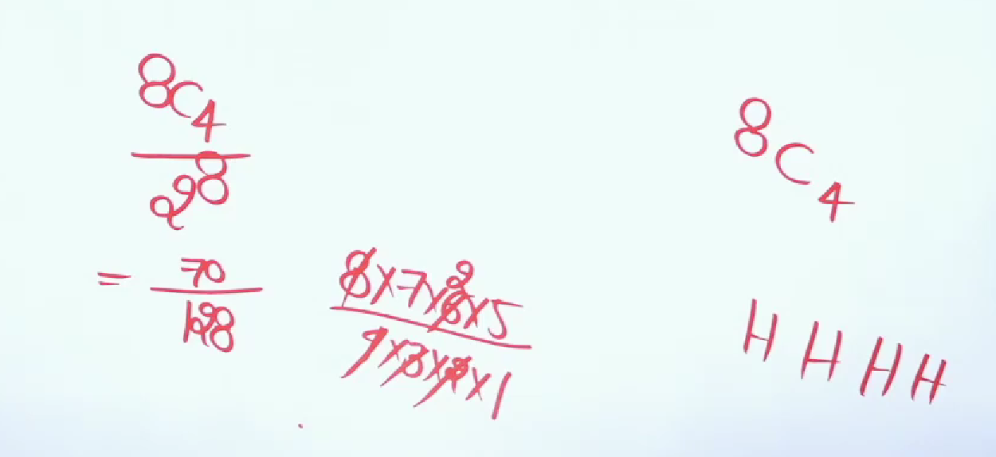
ANSWER:
Notes:
Ans: C) LAUNNCH

Slide 22
PRACTICE QUESTIONS:
The probability of getting at least one tail in 4 throws of a coin is?
15/16
1/16
¼
None of these
Notes:
Ans: a) 15/16

Slide 23
PRACTICE QUESTIONS:
A coin is tossed 5 times one after the other. Find the probability of getting at least 3 heads?
¼
3/32
½
1/5
Notes:
Ans: c) ½

Slide 24
PRACTICE QUESTIONS:
6 coins are thrown together. What is the probability of getting at least 4 heads?
21/32
11/32
11/64
None of these
Notes:
Ans: b) 11/32

Slide 25
PRACTISE QUESTION:
The probability of getting head and tail alternately in three throws of a coin (or throw of three coins) is?
1/8
¼
1/3
3/8
Notes:
Ans: b) ¼

Slide 26
PRACTICE QUESTIONS:
A fair coin is tossed repeatedly. If tail appears on first four tosses then the probability of head appearing on fifth toss equals?
½
1/32
31/32
1/5
Notes:
Ans: a) ½

Slide 27
PRACTISE QUESTION:
Three fair coins are tossed. If both heads and tails appears, then the probability that exactly one head appears, is?
3/8
1/6
½
1/3
Notes:
Ans: a) 3/8

Slide 28
PRACTICE QUESTIONS:
A coin is tossed a fixed number of times. If the probability of getting 4 heads equals the probability of getting 7 heads, then the probability of getting 2 heads is?
1/2024
55/2048
c) 3/4096
d) None
Notes:
Ans: b) 55/2048

Slide 29
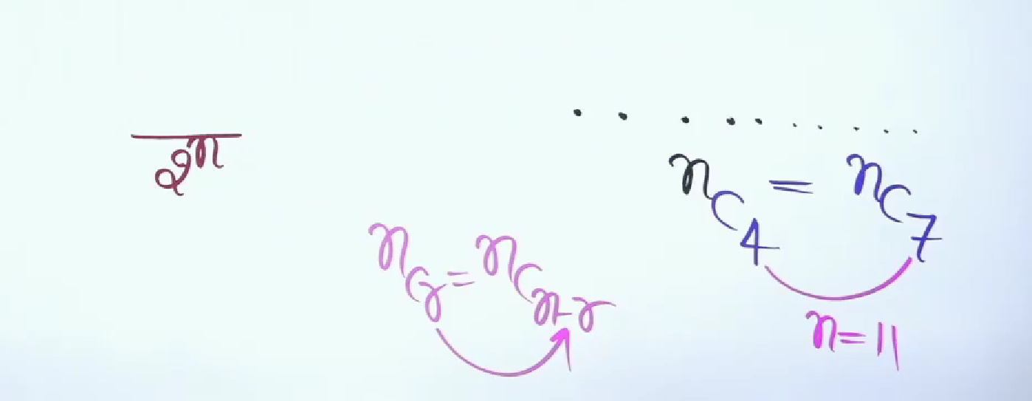
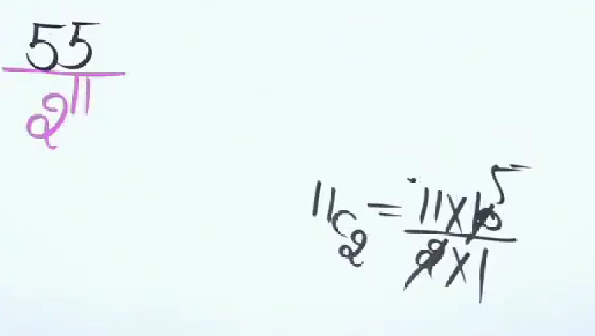
ANSWER:

Slide 30
Thank You

